Slide 1
Data visualization – 80 cereals

Slide 2
agenda
Introduction
Objective and Goal of case study
Methodology
Analysis
Conclusion and Recommendation

Slide 3
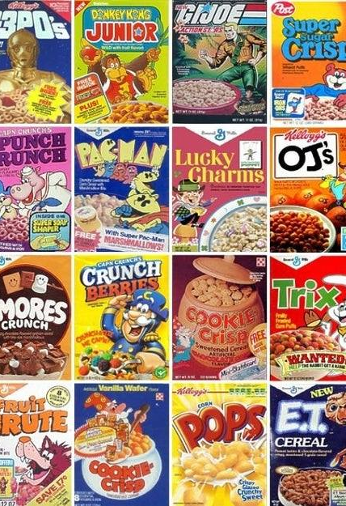
INTRODUCTION
This dataset provides nutritional information for 77 cereal products from various manufacturers, including key metrics such as calorie count, protein, fat, sodium, fiber, carbohydrates, sugars, potassium, and consumer ratings. In a health-conscious era, understanding the nutritional composition of these products is crucial for both consumers and businesses aiming to make informed decisions.

Slide 4

OBJECTIVE AND GOAL OF CASE STUDY
OBJECTIVE –
The objective of this analysis is to evaluate the nutritional composition of cereals to identify patterns, compare their health benefits, and determine which product can be classified as the "healthiest." Additionally, this case study aims to develop a scoring system or criteria for ranking cereals based on their nutritional profiles and ratings.
GOAL –
The goal is to provide actionable insights for cereal manufacturers to enhance their product offerings and cater to the needs of health-conscious consumers while empowering individuals to make informed choices. Through this analysis, the findings could influence marketing strategies, product innovation, and nutritional labeling practices.

Slide 5
methodology
Step 1 : Importing the warnings and required libraries
Step 2 : Understanding of the Dataset
Step 3 : Univariate Analysis
Step 4 : Bivariate Analysis
Step 5 : Overall Analysis
Step 6 : Feature Importance using Random Forest
Step 7 : Conclusion and Recommendation

Slide 6
analysis
Univariate Analysis
Bivariate Analysis
Comparison between Numerical columns.
Comparison between Categorical & Numerical columns.
Comparison between Categorical columns.
Analyzing pairwise relationships between numerical variables

Slide 7
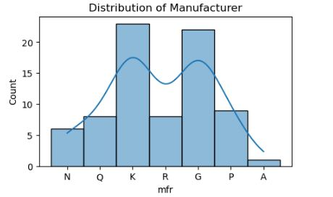
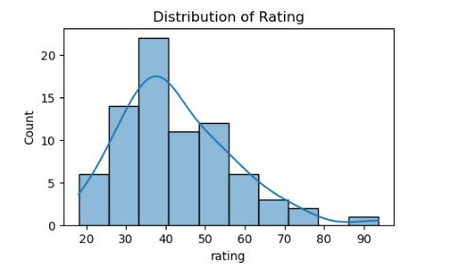
Univariate Analysis
Univariate Analysis means analyzing the columns separately to gather insights. In the dataset, we have analyzed the below columns individually to get the insights –
Manufacturer
Type
Calories
Protein
Fat
Sodium
Sugar
Vitamin
Rating

Slide 8
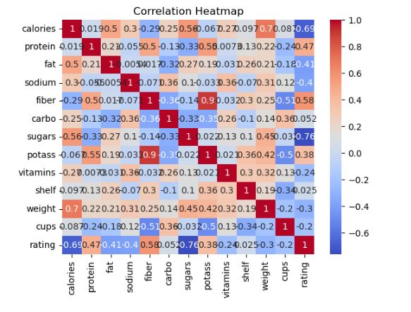
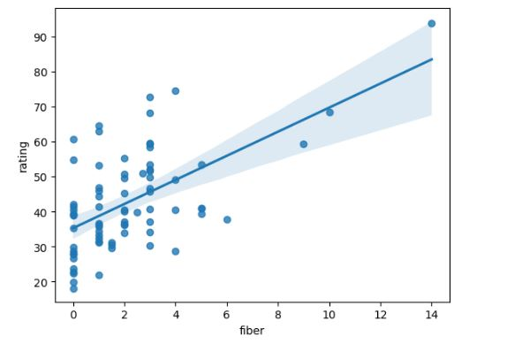
Bivariate analysis
Bivariate Analysis means that the data has been analyzed with respect to the columns and variables in order to draw insights. The below relationship has been used –
Comparison between Numerical columns.
Comparison between Categorical & Numerical columns.
Comparison between Categorical columns.
Analyzing pairwise relationships between numerical variables

Slide 9
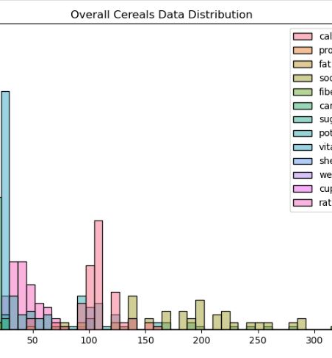
Conclusion and recommendation
Consumers are increasingly prioritizing healthier breakfast cereals with high fiber, low sugar, and whole grains, as evidenced by the top ratings of brands like All-Bran and Shredded Wheat.
Analysis reveals that sugar and calorie content are the most influential factors in cereal ratings, showcasing growing health consciousness. While fiber and sodium also impact preferences, attributes like protein, fat, and vitamins hold less sway.
Brands with sugary cereals, like Frosted Flakes and Trix, receive lower ratings, highlighting the shift towards mindful eating. Cereal manufacturers can capitalize on these insights by focusing on fiber-rich, low-sugar options to meet consumer demand for healthier choices.

Slide 10
Thank you
Chayanika Hazra
Gmail - chayanikahazra732@gmail.com
Linkedin - https://www.linkedin.com/in/chayanika-hazra-analytics/
Github - https://github.com/ChayanikaH/DataSaga

